Slide 1
Biogas Potential of the Inocula Sewage Sludge, Cow Manure, and Fermentation Residues – Investigation of Varying Pre-Treatment and Process Options
Interim Presentation
Alexandra Erfort
Circular Economy and Recycling technology
27.06.2018

Slide 2
Outline
Introduction
Objectives
Hypotheses
Materials and Methods
Results
Time Schedule

Slide 3
Introduction
Research in context of the BioRist project:
Pre-step for current research regarding optimization of biogas plant using water hyacinths and rice straw
Biogas potential of the inoculum on its own
Investigation of pre-incubation period under varying conditions

Slide 4
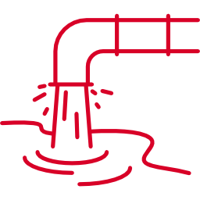


Introduction – Inocula
Sewage sludge
Cow manure
Fermentation residues
Fresh and stored
Screened and unscreened
Stirred and unstirred

Slide 5




Objectives
Compare residual gas-formation potential of sewage sludge, fermentation residues, and cow manure
During an incubation period of two weeks
Calculate the norm liters in regards to available organics
Investigate the effects of varying pre-treatment and process options
Create a guideline on how to implement this type of experiment in the institute’s laboratory
Based on the VDI 4630
Include a thorough error analysis

Slide 6
Hypotheses
Logistic Biological Activity [1]
Minimal Effect of Storage [2]
Screening Increases Gas Yield [3]
Little Effect of Not-Stirring [4; 5; 6]
p
t

Slide 7
Materials and Methods
Analyzed parameters:
Dry matter
Loss on ignition
C/N/S
Flushing with nitrogen → anaerobic environment
Incubation under mesophilic conditions (37 °C ± 2 °C) [7]
OxiTop delivers one measurement every hour for two weeks

Slide 8
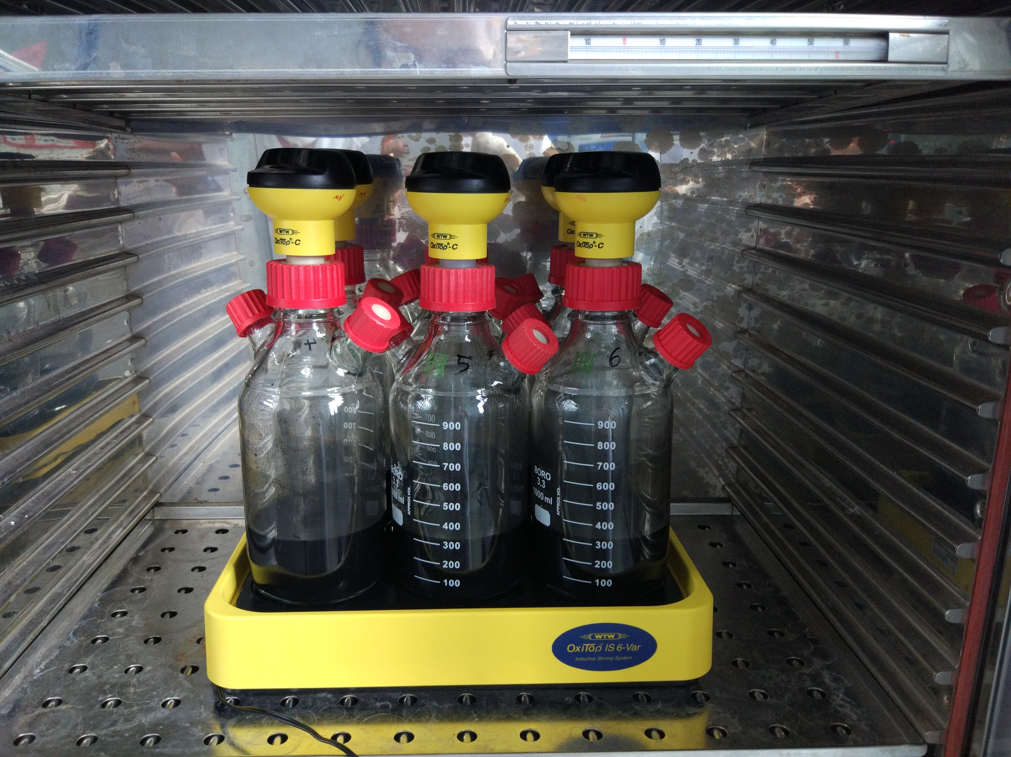
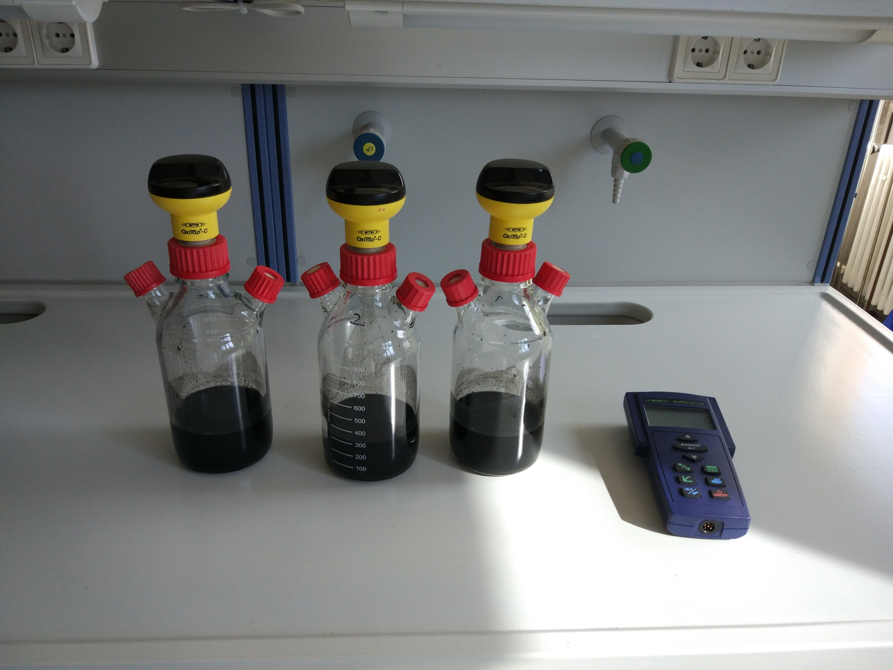
Materials and Methods
OxiTop Measuring Head
OxiTop Controller

Slide 9
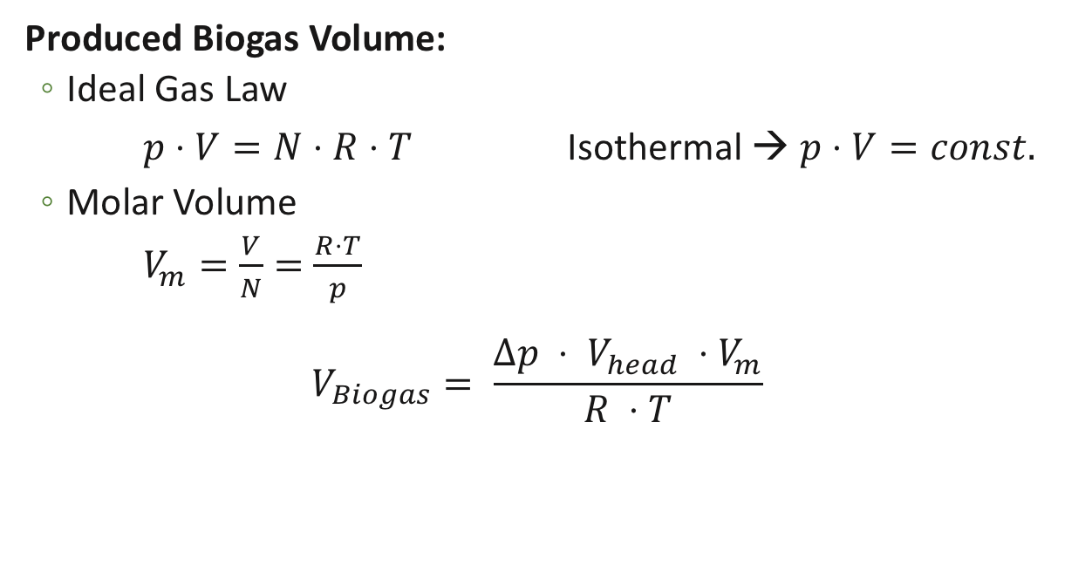
Materials and Methods – Calculation
Produced Biogas Volume:
Ideal Gas Law
$p⋅V=N⋅R⋅T$ Isothermal → $p⋅V=const.$
Molar Volume
$V_{m}=\frac{V}{N}=\frac{R⋅T}{p}$
$$V_{Biogas}= \frac{∆p ⋅ V_{head} ⋅V_{m}}{R ⋅T}$$
V_{Biogas} Δp V_{head} V_{m} R T | Biogas volume Absolute pressure difference Volume of the head space Molar volume Universal gas constant Absolute temperature

Slide 10

Results – Fresh Sewage Sludge
Hypotheses 1. Logistic Growth

Slide 11
Results – Stored Sewage Sludge
Hypotheses 1. Logistic Growth

Slide 12
Results – Fresh Vs. Stored Sewage Sludge
Hypotheses 2. Minimal Effect of Storage
(Fresh sludge has about twice as much potential)

Slide 13
Results – Unscreened Cow Manure
Hypotheses 1. Logistic Growth
(Experiment 7 excluded from evaluation)

Slide 14
Results – Screened Cow Manure
Hypotheses 1. Logistic Growth
(Near-linear growth even after 28 days)

Slide 15
Results – Unscreened Vs. Screened Cow Manure
Hypotheses 3. Screening Increases Gas Yield

Slide 16
Results – Stirred Fermentation Residues
Hypotheses 1. Logistic Growth

Slide 17
Results – Unstirred Fermentation Residues
Termination rate higher than for stirred fermentation residues

Slide 18
Results – Stirred Vs. Unstirred Fermentation Residues
Hypotheses 4. Minimal Effect of Stirring

Slide 19

Results – Hypotheses Confirmed?
Logistic Growth
Minimal Effect of Storage
Screening Increases Gas Yield
Little Effect of Not-Stirring

Slide 20
Results – NL/kg oTS
After two weeks

Slide 21
Time Schedule
 | April |  |  |  | May |  |  | June |  |  |  | July |  | August
Literature research
Experiments
Data analysis
Interim Presentation
Writing
Final Presentation |  |  |  |  |  |  |  |  |  |  |  |  |  | x
x
Today

Slide 22
Sources
[1] | Helmich, U.: Logistisches Wachstum. Helmichs Biologie-Lexikon. 2016. [Access: 24.05.2018. http://www.u-helmich.de/bio/lexikon/L/logistisches_Wachstum.html]
[2] | Browne, J. et al.: The effects of storage time and temperature on biogas production from dairy cow slurry. 2014. [Access: 09.05.2018: https://ac.els-cdn.com/S1537511014001615/1-s2.0-S1537511014001615-main.pdf?_tid=d89c68a7-4800-489d-9c15-b92e3fc6d42e&acdnat=1525898666_12a46d6ec82740a8b5f6b48d10a99962]
[3] | Sharma, S.K. et al.: Effect of particle size on biogas generation from biomass residues. Research Gate. 1988. [Access: 20.06.2018. https://www.researchgate.net/publication/223654307_Effect_of_particle_size_on_biogas_generation_from_biomass_residues]
[4] | R. Kliche; M. Lebuhn: Bayern Biogas Forum: Schaum in Biogasanlagen. 2017. [Access: 09.05.2018. http://www.biogas-forum-bayern.de/media/files/0003/schaum-in-biogasanlagen.pdf].

Slide 23
Sources
[5] | Dr. Schieder et al.: Prozessmodell Biogas. 2010. [Access: 24.05.2018. http://www.biogas-forum-bayern.de/media/files/0001/Prozessmodell-Biogas.pdf]
[6] | H. Klußmann: Pump- und Rührtechnik in landwirtschaftlichen Biogasanlagen. N.Y. [Access: 09.05.2018. http://www.bfl-online.de/media/pump_und_%20ruehrtechnik_in_%20biogasanlagen.pdf].
[7] | Verein Deutscher Ingenieure: VDI 4630. 2016.
Image source from slides 4, 5, and 19: flaticon.com

Slide 24
Cảm ơn bạn đã quan tâm của bạn!
Thank you for your attention!
Vielen Dank für Ihre Aufmerksamkeit!

Slide 25
Additional Slides

Slide 26
Thesis Structure
1. Introduction
2. Background
2.1.Anaerobic Digestion
2.2.Inocula and their Environmental Impact
2.3.Inocula in Existing Biogas Plants
2.4.VDI 4630
2.5.Batch Tests
2.6.OxiTop-C Measuring System
2.7.Normal Volume
3. Materials and Methods
3.1.Sample Materials
3.1.1. Collection and Storage of Samples
3.2.Analyses of Parameters (Dry Substance, Loss on Ignition, C/N/S, Density)
3.3.Preparation of the Inocula
3.4.Preparation of the Testing System
3.5.Incubation
3.6.Calculations
3.7.Analyses at the End of the Batch Test
4. Results
4.1.Inoculum Parameters
4.2.Incubation Results
4.2.1.Comparison of Different Inocula
5. Discussion
5.1.Biogas Production Rate
5.1.1.Comparison of All Six Different Inocula
5.2.VDI 4630
5.3.Error Analysis
6. Conclusion

Slide 27
Results – Overall Comparison
Notes:
Nochmal genauso für NL und NL/kg

Slide 28
Results – Norm Liters
Inoculum |  | NL | oTS available [g] | NL / kg oTS
Fresh Sewage Sludge | 1 | 1.00 | 4.01 | 249.55
 | 2 | 0.88 | 4.03 | 218.74
 | 3 | 1.00 | 4.10 | 243.17
Stored Sewage Sludge | 1 | 0.27 | 3.32 | 81.04
 | 2 | 0.29 | 3.32 | 86.91
 | 3 | 0.27 | 3.33 | 80.36
Unscreened Cow Manure | 1 | 0.36 | 6.87 | 51.86
 | 2 | 0.41 | 7.32 | 55.47
 | 3 | 0.35 | 6.75 | 51.11

Slide 29
Results – Norm Liters
Inoculum |  | NL | oTS available [g] | NL / kg oTS
Screened Cow Manure | 1 | 2.68 | 3.71 | 721.17
 | 2 | 2.38 | 3.68 | 647.09
 | 3 | 2.18 | 3.60 | 607.24
Stirred Fermentation Residues | 1 | 1.68 | 10.57 | 159.09
 | 2 | 1.86 | 11.22 | 165.71
 | 3 | 1.93 | 10.88 | 176.92
Unstirred Fermentation Residues | 1 | 1.35 | 11.11 | 121.82
 | 2 | 1.56 | 11.29 | 137.71
 | 3 | 1.81 | 11.01 | 164.13

